Slide 1
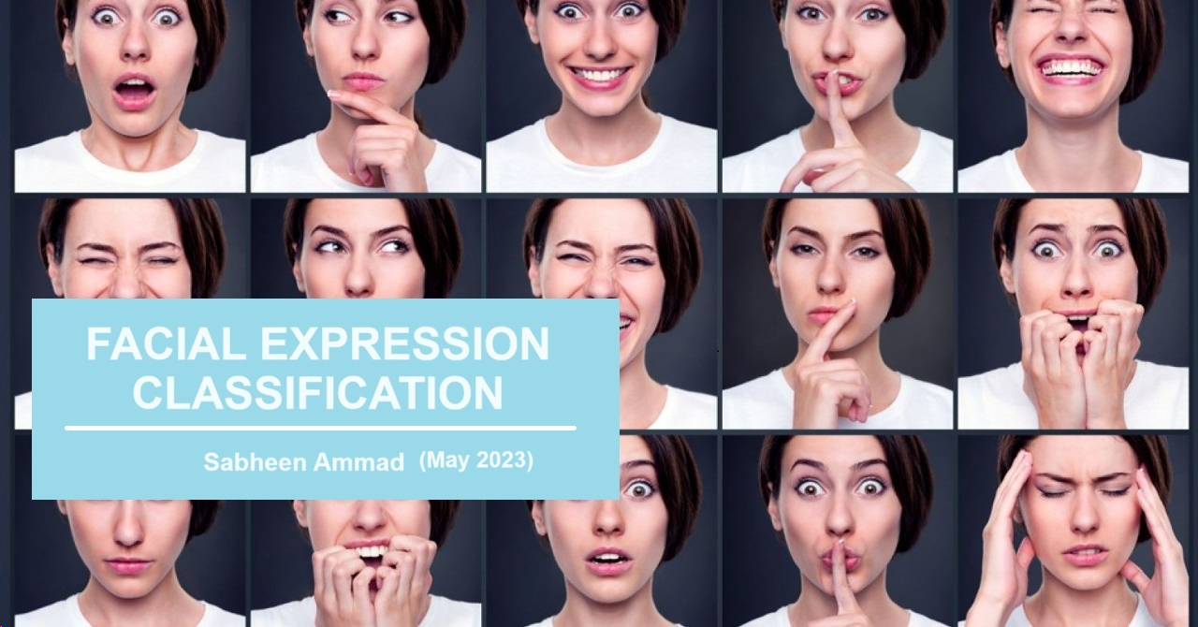

Slide 2
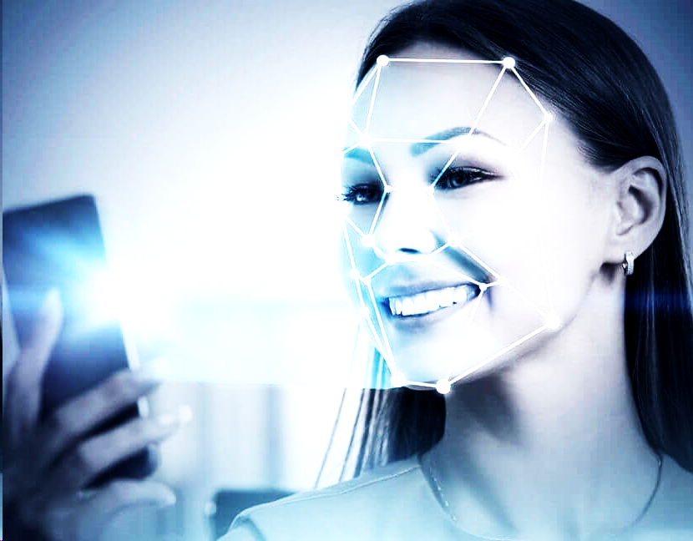
INTRODUCTION
Facial Expression Recognition (FER) is a technology that involves the detection and analysis of human facial expressions to identify the emotional state of an individual. The primary goal of FER is to recognize and interpret the various facial expressions that convey emotions such as happiness, sadness, anger, surprise, fear, and disgust. This technology has applications in diverse fields, including human-computer interaction, healthcare, marketing, and security.
Key Steps in Facial Expression Recognition:
Face Detection
Feature Extraction
Classification of Expression

Slide 3

AREAS
Facial Emotion Recognition (FER) technology is being used in various areas across different industries .
Entertainment and Gaming:
Marketing and Advertising:
Healthcare:
Human-Computer Interaction:
Education:Customer Service:
Security and Surveillance:
Autonomous Vehicles:
Market Research:
Employee Engagement:

Slide 4
AUDIENCE
In the context of Facial Expression Recognition (FER), the audience can vary depending on the specific application or purpose of the system.
Researchers and Academia:
Developers and Data Scientists:
Industry Professionals:
Human-Computer Interaction (HCI) Specialists:
Educators and Students:
Healthcare Professionals:
Policy Makers and Ethicists:

Slide 5
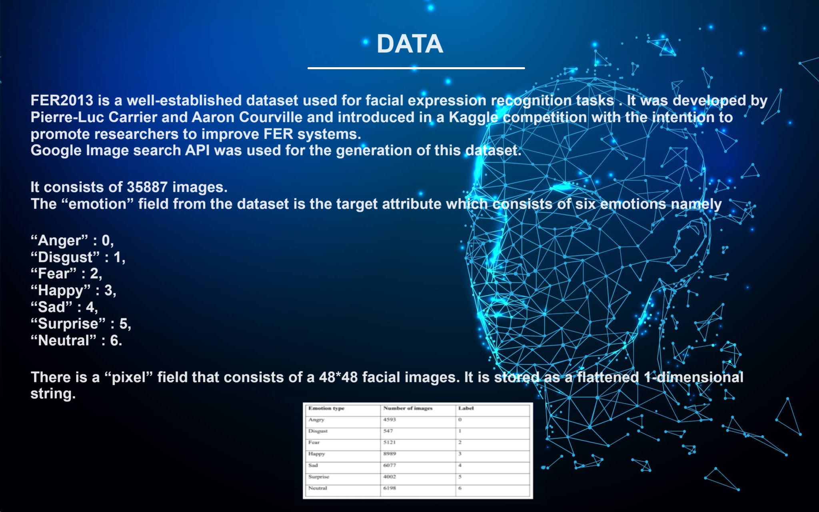

Slide 6
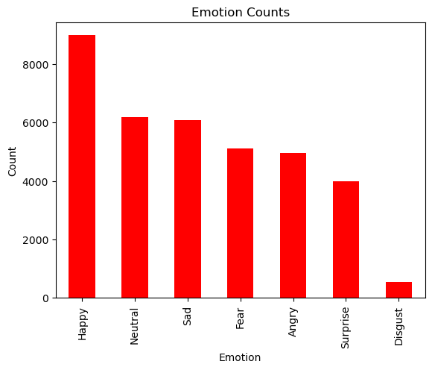
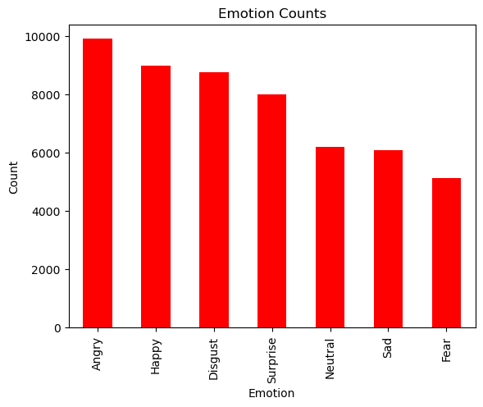
DATA WRANGLING AND EDA
Converted pixel values in string format to array format
No Null values
Checking No of samples in each emotion.It reveals a significant imbalance in the data distribution.

Slide 7
MODELLING
DEEP LEARNING
CONVOLUTIONAL NEURAL NETWORKS
RESNET
TOOLS: PANDAS, TENSORFLOW, KERAS, MATPLOTLIB ,OPENCV, STREAMLIT

Slide 8
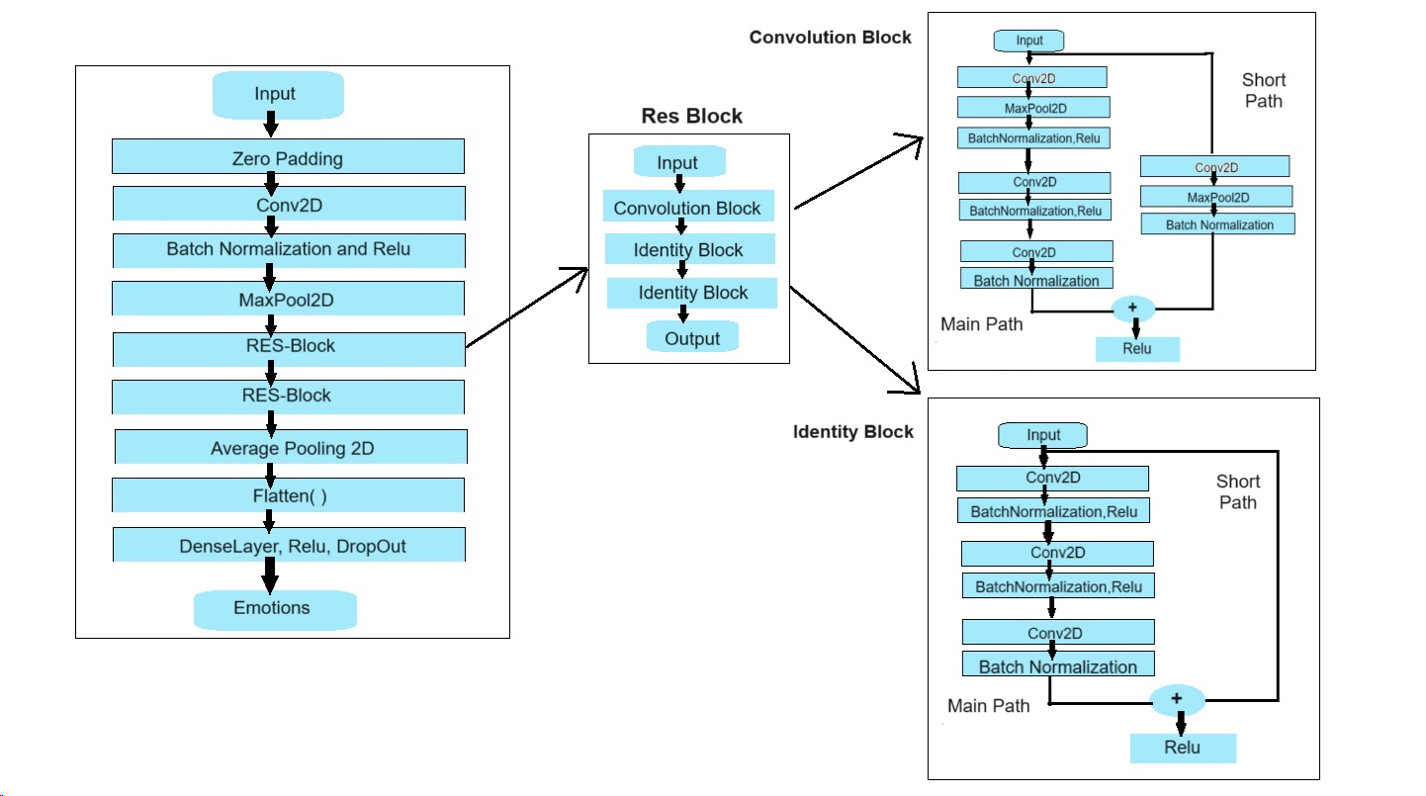
CNN ( RESNET )

Slide 9
CONVOLUTIONAL NEURAL NETWORK :
A Convolutional Neural Network (CNN) is a type of deep neural network designed for processing and analyzing visual data, such as images. CNNs are particularly effective in tasks like image recognition, object detection, and facial expression classification.

Slide 10
CONVOLUTIONAL NEURAL NETWORK :
Key Components of CNN:
Convolutional Layers: These layers apply convolution operations to the input data, allowing the network to detect spatial patterns and features. Convolution involves sliding a filter (kernel) over the input to extract local patterns.
Pooling Layers: Pooling layers reduce the spatial dimensions of the input data by down-sampling. Common pooling operations include max pooling, where the maximum value in a region is retained, and average pooling, where the average value is taken.
Activation Functions: Non-linear activation functions (e.g., ReLU - Rectified Linear Unit) introduce non-linearity to the network, enabling it to learn complex relationships in the data.
Fully Connected Layers: These layers connect every neuron from one layer to every neuron in the next layer, enabling the network to make final predictions based on the learned features.

Slide 11
RESIDUAL NETWORK:
ResNet, short for Residual Network, is a deep neural network architecture designed to address the challenges of training very deep neural networks. It was introduced by Kaiming He, Xiangyu Zhang, Shaoqing Ren, and Jian Sun in their 2016 paper titled "Deep Residual Learning for Image Recognition."
The key innovation in ResNet is the use of residual blocks, which include shortcut connections or skip connections. These connections enable the network to learn residual functions, making it easier to train very deep networks by mitigating the vanishing gradient problem.

Slide 12
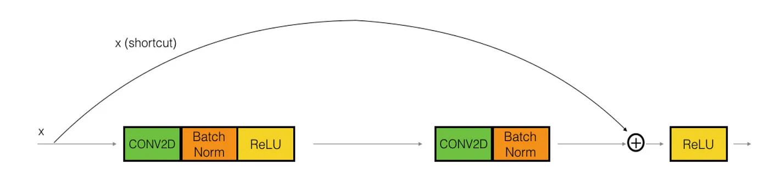
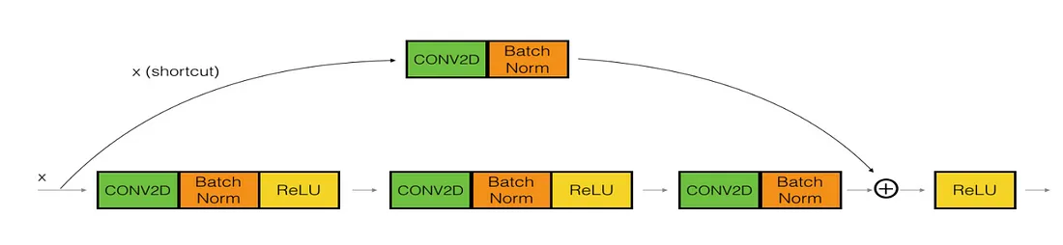
RESIDUAL NETWORK:
1. The identity block: The identity block is the standard block used in ResNets and corresponds to the case where the input activation has the same dimension as the output activation.
2. The Convolutional block — We can use this type of block when the input and output dimensions don’t match up. The difference with the identity block is that there is a CONV2D layer in the shortcut path.

Slide 13
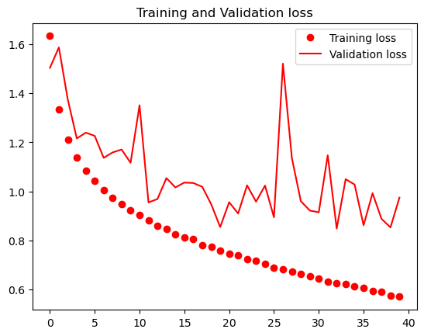
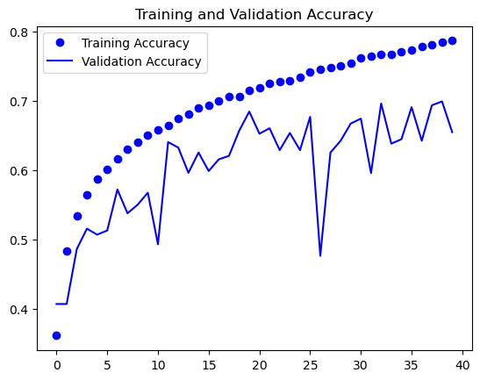
ACCURACY/LOSS

Slide 14
ACCURACY/LOSS
Training Accuracy represents the accuracy of the model on the training dataset. It shows how well the model is learning from the training data over epochs whereas Validation Accuracy reflects the model's performance on a separate validation dataset not seen during training.
Training Loss represents the error or loss on the training data and Validation Loss reflects the error or loss on the validation dataset.

Slide 15
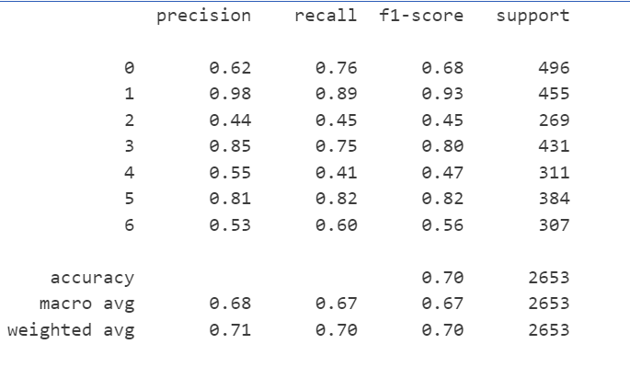
CLASSIFICATION REPORT

Slide 16
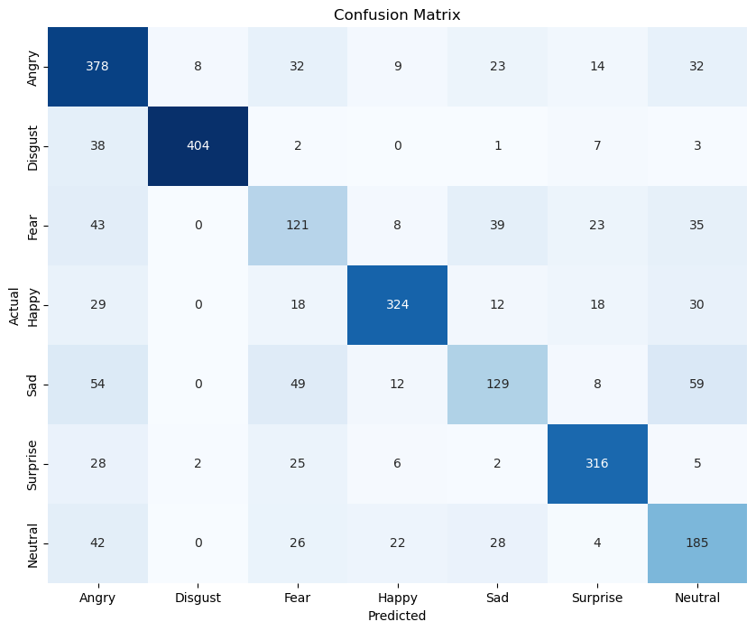
MODEL EVALUATION
Accuracy never tells the whole story - so we need to use other metrics. We use precision, recall and the F1-score to evaluate the model.
But the most visually impactful method of evaluation is the confusion matrix. At a glance, one can identify the outcome of any issues in the model.

Slide 17
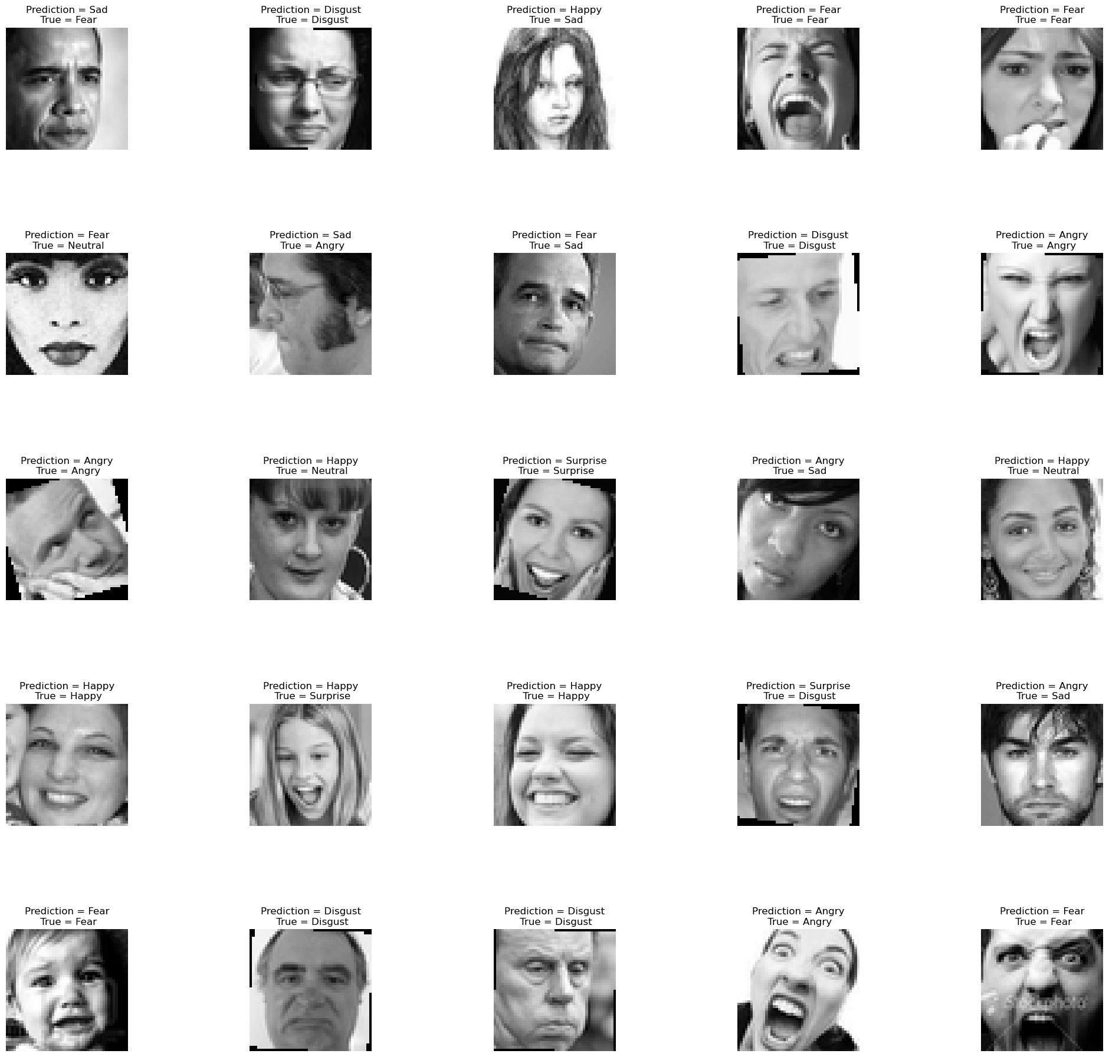
MODEL FORECASTING

Slide 18
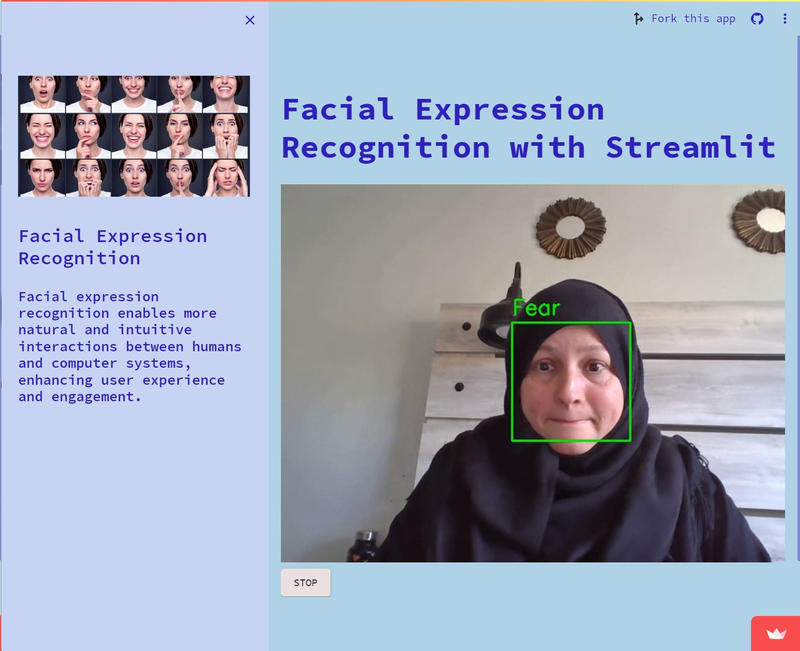
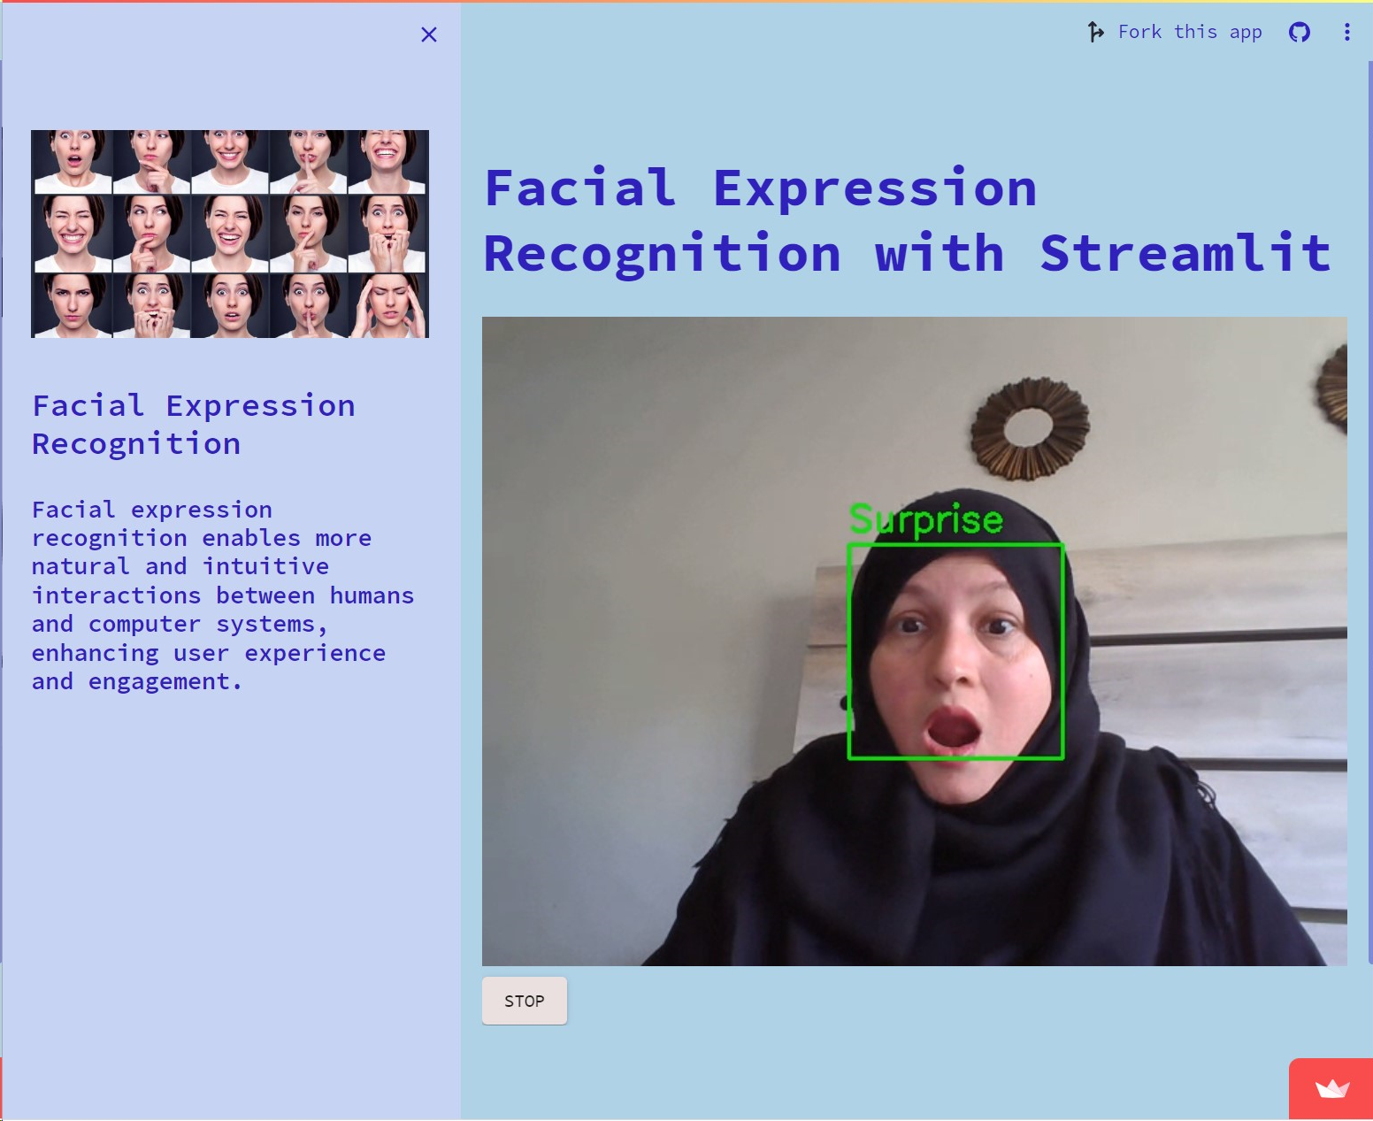
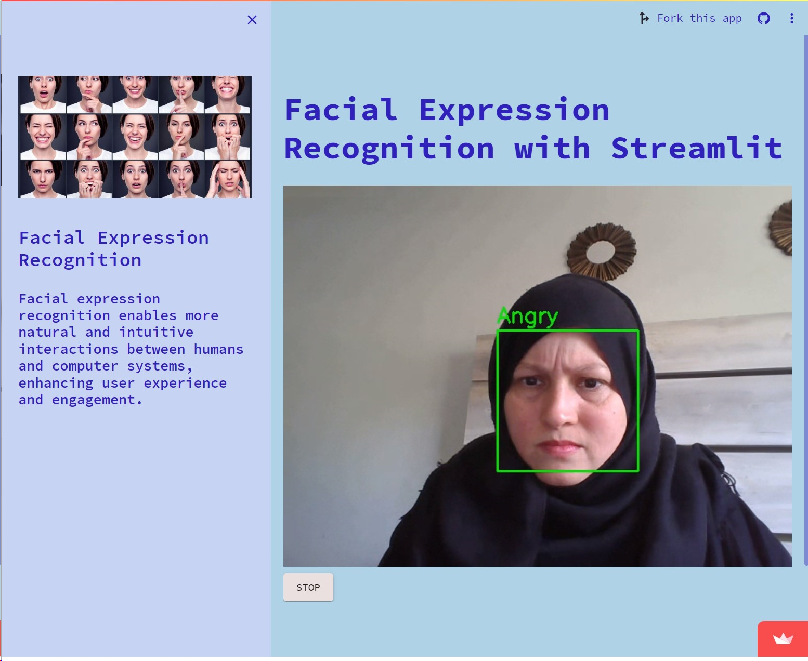
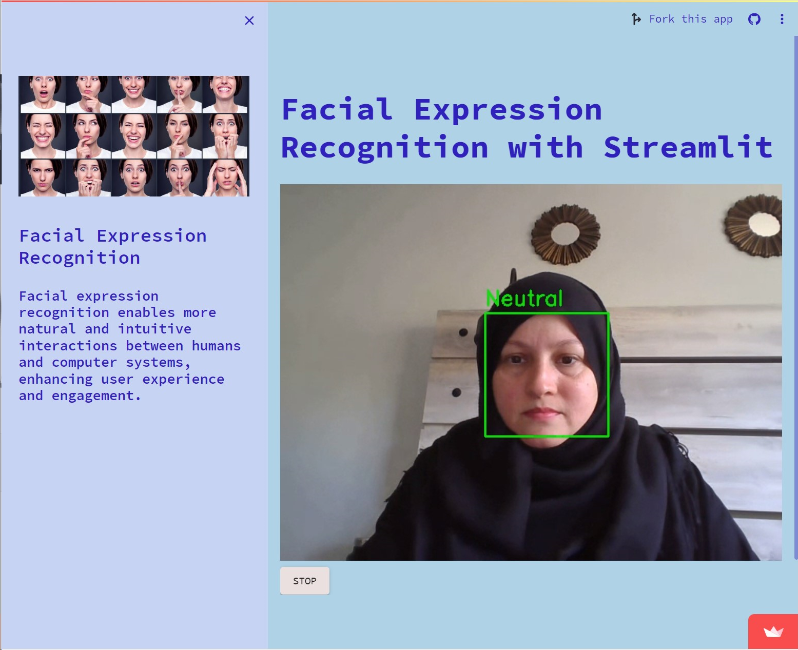
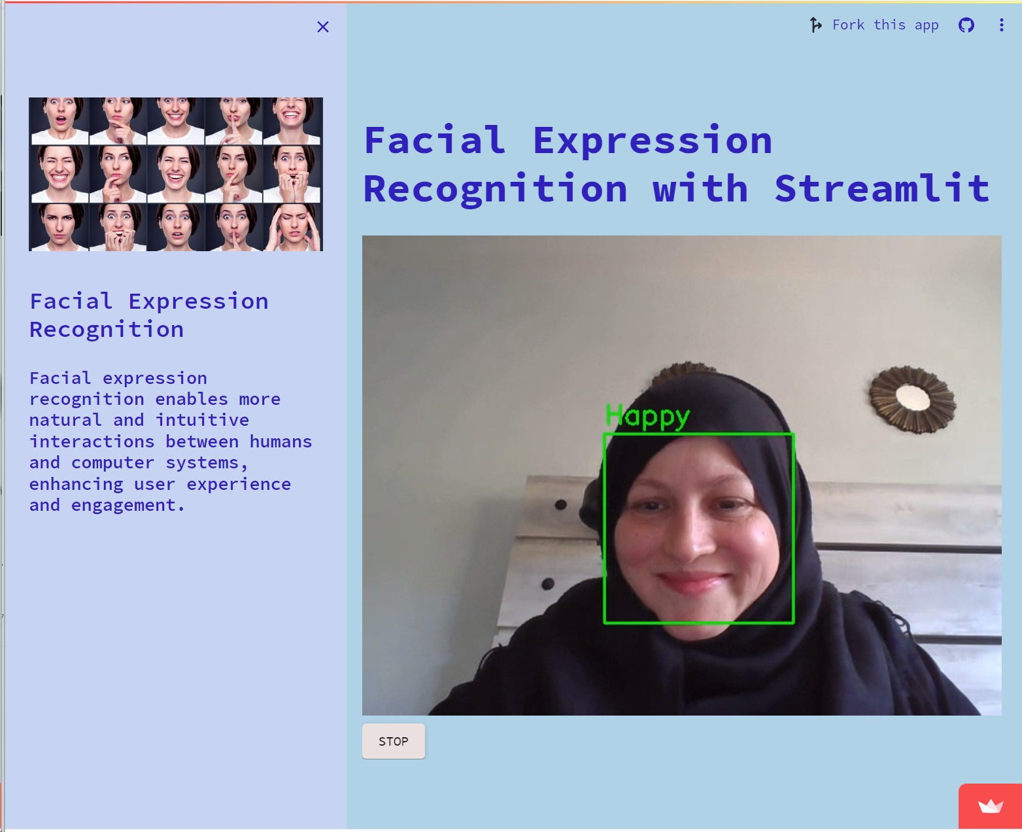
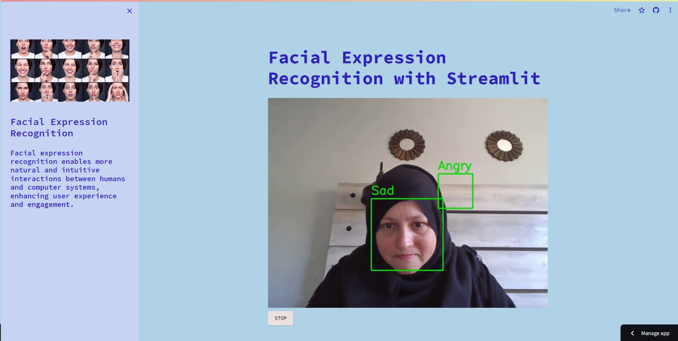
WEB APPLICATION

Slide 19
https://firstappapp-h7puengxkucbekipr46ia3.streamlit.app/

Slide 20
FUTURE RESEARCH OR IMPROVEMENTS
An avenue for future exploration involves assessing the performance of different ResNet architectures for Facial Expression Recognition. Comparing and contrasting the outcomes of distinct ResNet models, such as ResNet-50 and ResNet-101, can provide valuable insights into the impact of network depth on recognition accuracy
Additionally, expanding the dataset to encompass a broader range of demographics and expressions will contribute to a more robust and inclusive model.

